Slide 1


Institute for Advanced Computing and Software Development
Project Presentation on
“E-Banking”
PG-DAC Feb 2020
Submitted By :
Prerana Gholap (200241220142)
Megha Chaudhari (200241220033)
Mr. Prashant Karhale
Center Coordinator
Mr. Chetan Pardeshi
Project Guide

Slide 2
Introduction
Objective:
The E-banking is for Bank web application is intended to provide complete solutions for Bank Users.
Users can browse through the Portal and access them online without visiting the Bank physically.
Scope:
This personalize banking portal will allows the users to access banking services 24x7.
Everything will be available sitting at any comfortable place instantly.

Slide 3
In this proposed system, we have two main entities such as,
User
who can access bank portal
Admin
who is managing requests coming from user

Slide 4
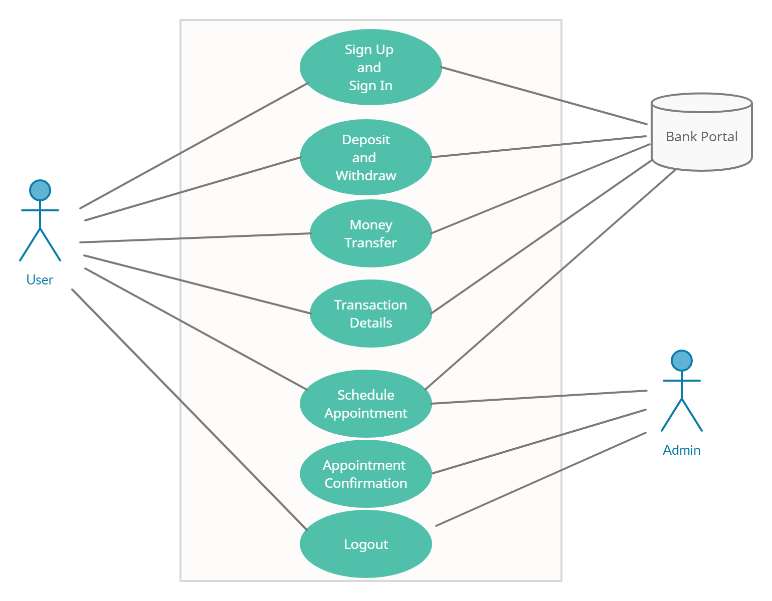
Use case diagram

Slide 5
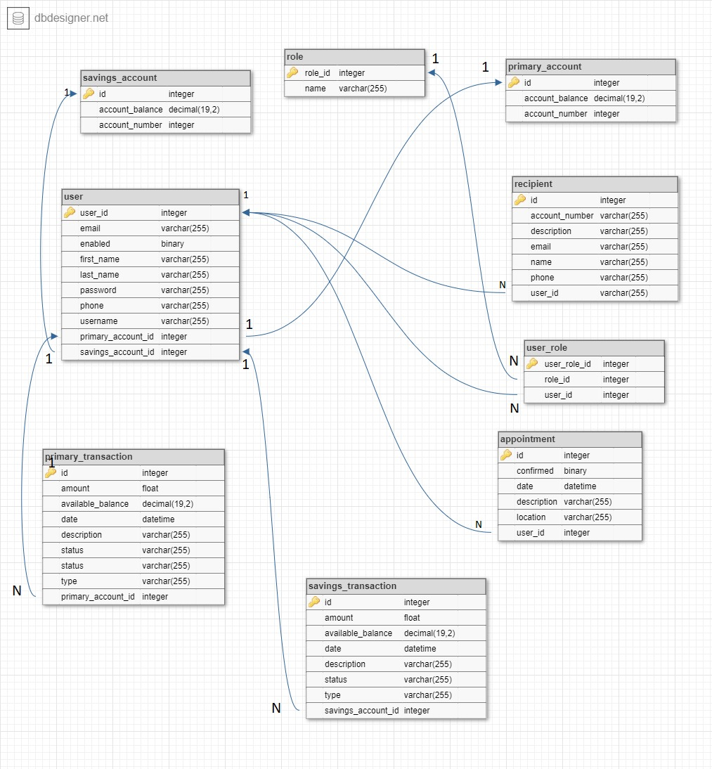
ER Diagram

Slide 6
Project Features
Application will let you deposit or withdraw money, schedule an appointment with a banker, view transactional details, transfer money between primary or savings account or with another customer.
By Creating two separate server:
User Frontend (used technology Spring Boot)
Admin Portal (used technology Angular )

Slide 7
User Frontend
User-Front is a user-facing system.
It includes modules such as
User sign up/sign in
User profile and change setting
Transfer between accounts
Transfer to other recipient
Appointment scheduling
Technologies:
Spring Boot
HTML5/CSS3, Bootstrap
Hibernate
MySQL

Slide 8
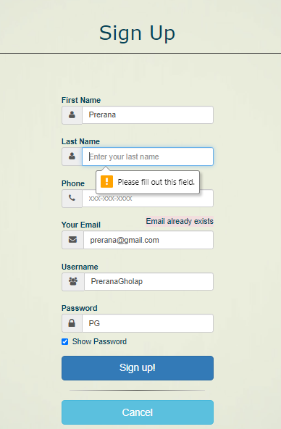
Validations on Sign Up :
All fields are required
Max length for phone number is 10 is indicated with format xxx-xxx-xxxx
Sign up with same Email id Not allowed
Database Entry on MySQL after User Sign Up with encrypted password

Slide 9



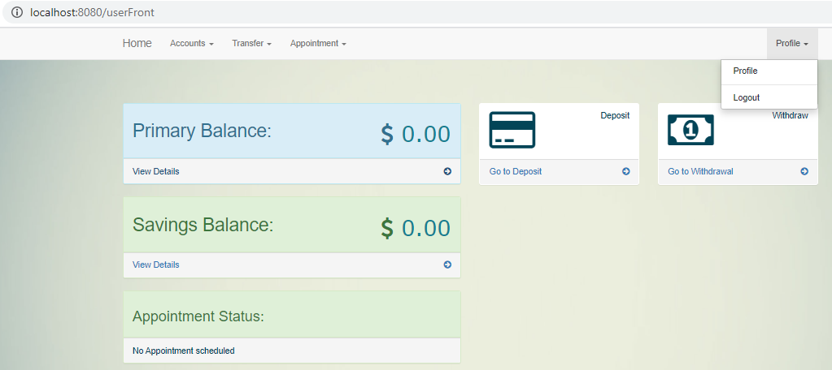
Functionalities implemented for user front:
Detailed view of profile Shown on next page
Home page URL

Slide 10
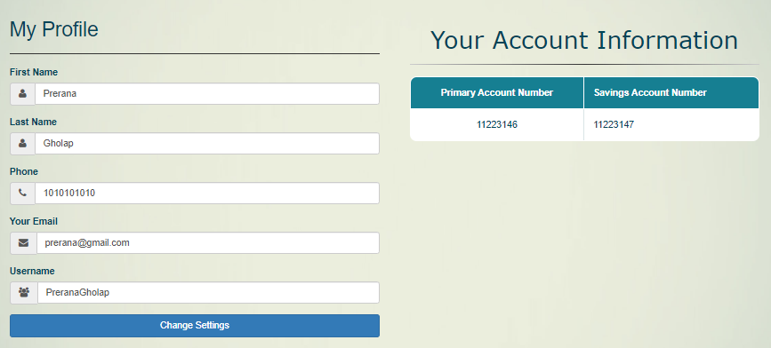
User can change credentials anytime after sign up :
This button will allow user to change credentials, email, password, phone number and username after Sign Up.
(Continue…)

Slide 11
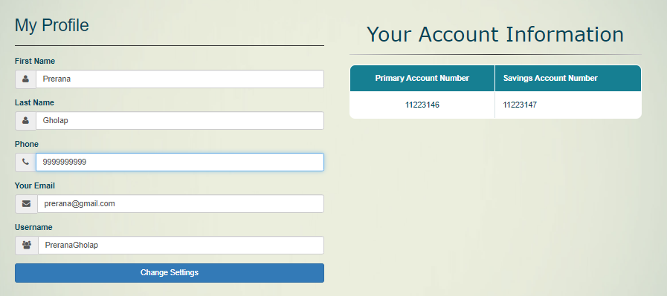
(Continue…)
Updated Phone Number Reflecting in Database
Before Updating :
After Updating :

Slide 12
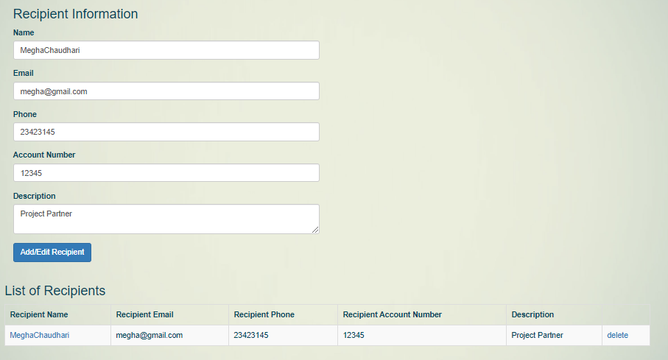
Adding Recipient to List :
(Continue…)

Slide 13
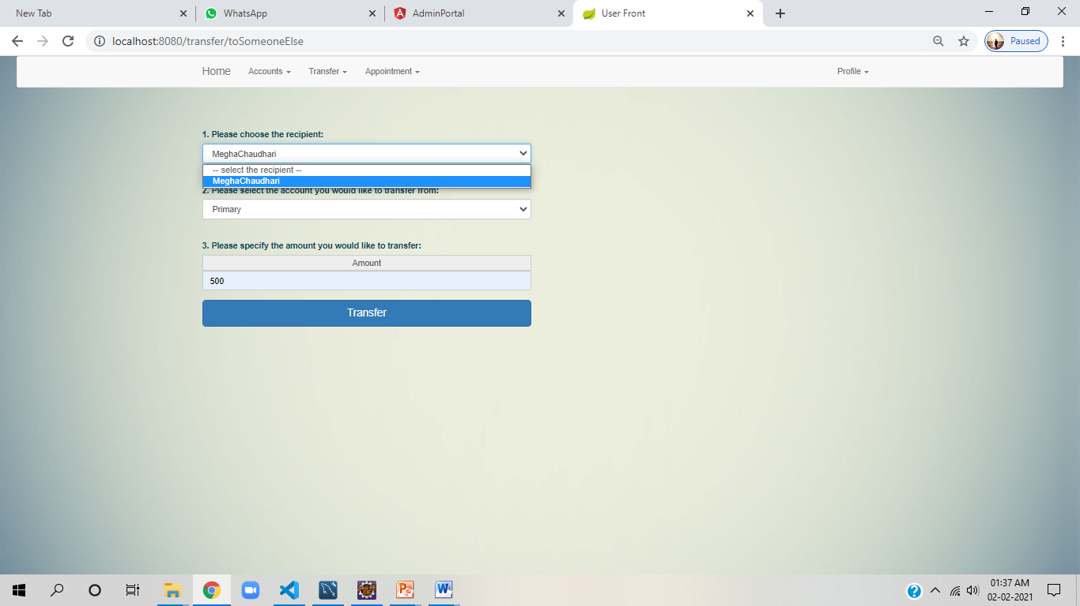
Only after adding recipient, user can transfer money to some one else account.
Account number of recipient user need to verify manually.

Slide 14
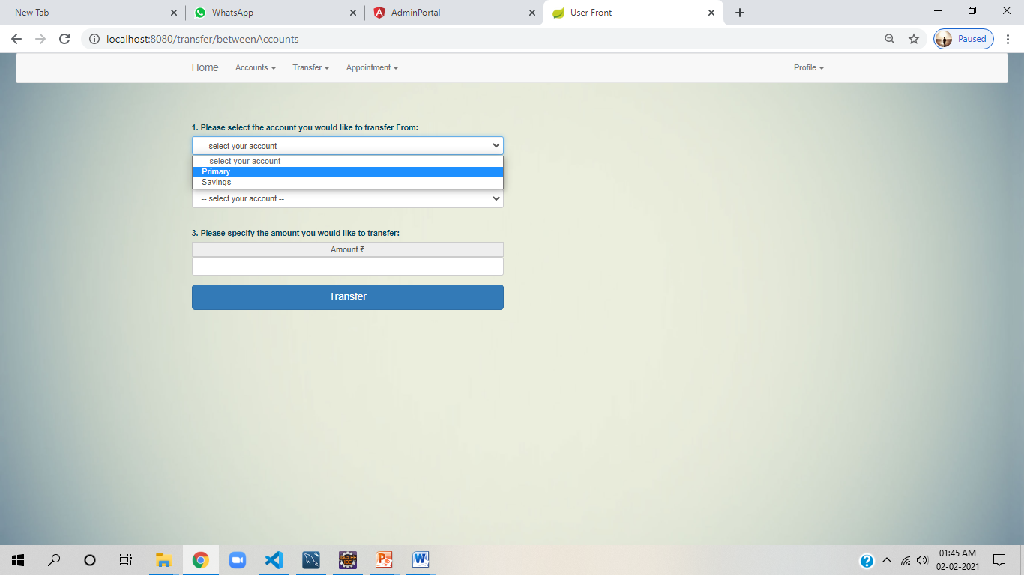
Transfer Between Accounts:
If user selects transfer from Primary account then it will reflect on transfer to other option is Savings only.

Slide 15
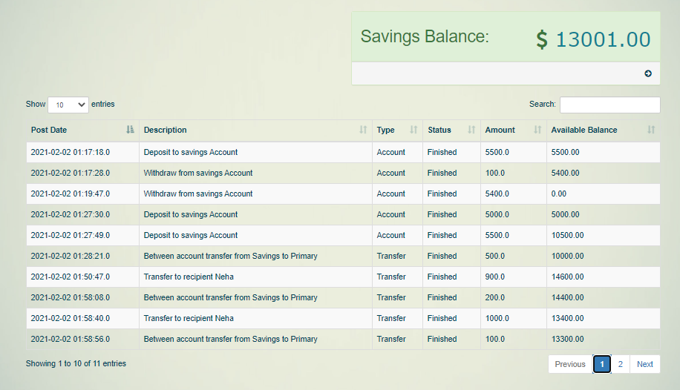
View Transaction Details:
User can see 10 entries per page.
User can search keyword for viewing specific transaction by amount or description whatever he/she remembers.

Slide 16
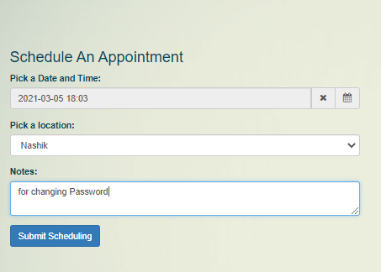
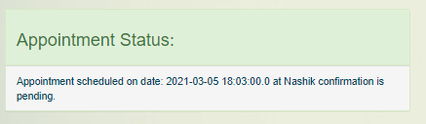
Appointment scheduling by user:
User can schedule appointment.
Its pending status will reflect on home page of user login.
(status is managed by binary flag in database)

Slide 17
Admin Portal
Admin portal mainly used by bank officers .
It involves User Account and Appointment modules.
They can confirm an appointment.
Technologies:
Node JS
NPM
Angular Client
Typescript

Slide 18
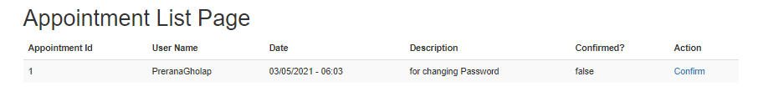
Appointment request received to bank officer:
Database entry:
Here, in database confirmed is Boolean flag.
Whenever bank officer will confirm then it will set to one & will be reflecting on userfront.

Slide 19
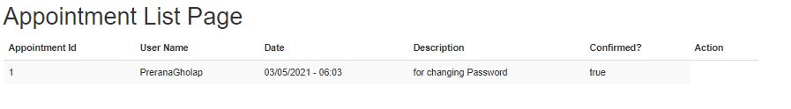
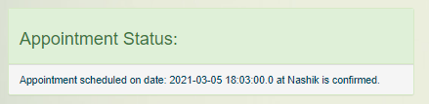
As soon as bank officer will confirm appointment request.
It reflects confirmed flag is set to 1 in database.
Appointment status on User front will be confirmed.

Slide 20
Enhancement
By adding cheque book deposition module and other card services.
Email alerts for various services in the society can be added to the system so that users do not miss the updates of the bank.

Slide 21
Drawbacks:
We need internet connection is mandatory for accessing portal.
While user transferring money to other recipient, he/she needs to verify account number manually.

Slide 22
Thank You …..!!!

